Slide 1

Diabetes Prediction in Healthcare at Early Stage Using Machine Learning Approach_{[1]}
CSE 713: Individual Paper Presentation
Presented By
Presented To
ST - Ehsanur Rahman Rhythm
RA- Md Humaion Kabir Mehedi
Team - 09
Marufa Kamal - 22366033
Annajiat Alim Rasel
Senior Lecturer,
Dept of Computer Science and Engineering, BRAC University

Slide 2
Index
1
Introduction
2
Dataset Collection and Preparation
3
Methodology
4
Results and Discussion
5
Conclusion and Future Works
4
References

Slide 3
Introduction
Diabetes is an incurable disease caused by an imbalance of sugar level, environmental factors or can be hereditary.
The International Diabetes Federation announced, there were 382 million people with diabetes mellitus in 2013, accounting for 6.6 percent of the overall adult population of the planet.
Diabetes is classified into two categories: type-1 and type-2.
Type-1 diabetes typically affects people under 40 and requires insulin therapy.
Type-2 diabetes affects middle-aged people and is associated with other diseases like arteriosclerosis, obesity, hypertension, and dyslipidemia.

Slide 4
Introduction
Diabetic patients have decreased immunity and are at risk of developing other diseases, particularly cardiovascular disease.
Various tissues, organs and body functions are affected by diabetes, including kidneys, eyes, blood vessels, nerves, and heart.
According to different researches, machine learning algorithms like
  Logistic Regression,
  Support Vector Machine,
  K-Nearest Neighbor,
  XGBoost,
  and Random Forest can be used to predict diabetes early, based on dangerous factors.

Slide 5
Dataset Collection and Preparation
Collected 289 samples of type -2, from khulna Diabetes Center, Khulna, Bangladesh.
Changed the categorical values to numeric values such as male - 0, female - 1.
Divided the dataset 75% for training, and 25% for testing purpose.

Slide 6
Dataset Collection and Preparation
SL No. | Attributes | Type | Values
1. | Age | Continuous | {18 to 85}
2. | Height | Continuous | {130 to 180}
3. | Weight | Continuous | {32 to 100}
4. | BMI | Continuous | {14.4 to 42.2}
5. | Duration of Diabetes | Continuous | {0 to 20}
6. | Diastolic Blood Pressure | Continuous | {90 to 200}
7. | Systolic Blood Pressure | Continuous | {60 to 130}
8. | FBS | Continuous | {4.3 to 24}
9. | PPBS | Continuous | { 5 to 28.5}
10. | Urine color of FBS | Nominal | {Blue, Green, Green Yellow, Lemon Green, Orange, Red, Yellow}
11. | Urine color of PPBS | Nominal | {Blue, Brick Red,Green, Green Yellow, Lemon Green, Orange, Red, Yellow}
12. | Type of medicine | Nominal | {Insulin, Tablet}
13. | Class | Nominal | {1,2}
14. | Gender | Nominal | {Male, Female}
Table 02: Dataset Description

Slide 7
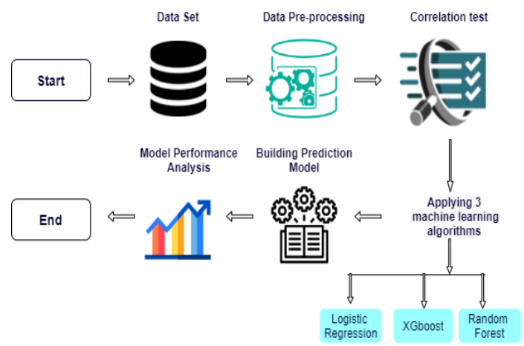
Methodology
Figure 1. System Architecture of this study

Slide 8
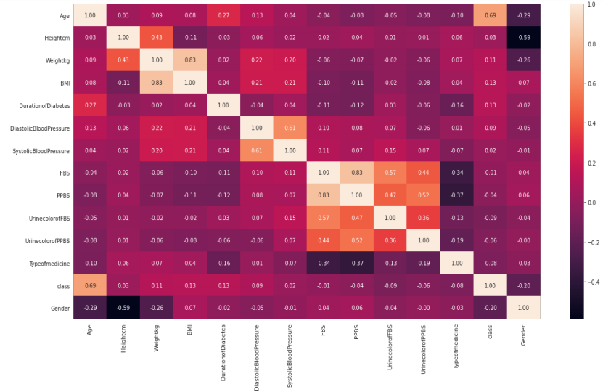
Correlation test between all features is displayed
Figure 2. Correlation test of the dataset

Slide 9
Result and Discussion
ML Algorithms | Accuracy | Precision | Recall | F1-Score
Logistic Regression | 88% | 81% | 95% | 88%
XGBoost | 86.36% | 82% | 93% | 87%
Random Forest | 86.36% | 80% | 98% | 88%
Table 01: MODEL PERFORMANCE OF ALL ALGORITHMS.

Slide 10
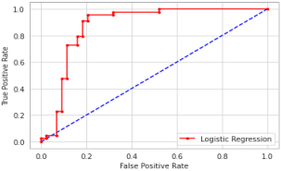
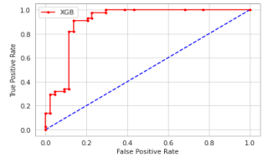
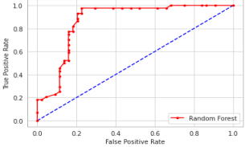
Result and Discussion
Fig 3: ROC Curve of Logistic Regression
.
Fig 5: ROC Curve of XG Boost
.
Fig 4: ROC Curve of Random Forest
.

Slide 11
Conclusion and Future Work
Irrespective of the small dataset they have achieved a comparatively good result.
The focus was on Type-2 diabetes data, and a model was developed using Logistic Regression, XGBoost, and Random Forest algorithms.
Future work will focus on developing an application with expert systems that can predict the disease and provide suggestions for medicine and daily activities and increasing the number of samples to build a better model

Slide 12
Reference List
[1] Hassan, M. M., Peya, Z. J., Mollick, S., Billah, M. A. M., Shakil, M. M. H., & Dulla, A. U. (2021, July). Diabetes prediction in healthcare at early stage using machine learning approach. In 2021 12th International Conference on Computing Communication and Networking Technologies (ICCCNT) (pp. 01-05). IEEE.

